Slide 1
Project 2
Chloe VanCory, Kalyn Howes, and Bevan Smith

Slide 2
arXiv Search Engine
Background of who uses it and why
Google

Slide 3
Page Rank Algorithm

Slide 4
Our Implementation - GUIDE
Using sqlite db to store all attributes from the metadata file
Why we are using this
Fast data structures for querying under the hood
What is an sqlite database
Simulating a sparse matrix.
Define sparse matrix previous implementations
Discuss how ours is easier and how it works
How it works
We store the current paper being read in an index and store the index of the paper it cites
Query the database to do this

Slide 5
Our Implementation - GUIDE
Our sparse matrix
Stores the indices of where the 1’s would be in the original matrix
We use the global index in the DB as reference
Example
Powermethod with the sparse matrix
Refers to the global index

Slide 6
SQLITE Database
What is it?
A relational database management system written in C
Advantages
Uses a “B – Tree “ (Balancing Tree) for indexed columns to quickly retrieve information from a given query.
We can take advantage of indexing certain columns that will be queried often
O(log n) VS O(n)

Slide 7
Our Program
Using the arxiv-metadata.txt file create a new DB “meta”
For every line in the file store the Paper ID, Title, Author, Abstract and Row number
Then “index” the ind and the PaperId columns

Slide 8
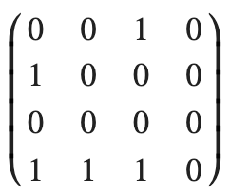
Sparse Matrices
Definition: A matrix whose values are mostly 0.
Relevance to Pagerank:
Generally papers will have a small number of citations compared to the total number of papers in the list.
Papers will have a small number of non-zero entries as most papers will not
EX:
Paper 1 has citation(s): paper 2
Paper 2 has citations: paper 1
Paper 3 has citations: paper 1 and 2

Slide 9
Our Implementation
For every paper store the index of where the 1’s would be if we had stored this using a standard matrix
Now we can use the same logic of the power method just a different method of accessing the data.
ID
1
2
3
4
Data
[3]
[1]
[]
[1,2,3]

Slide 10




Power Method
A
[3]
[1]
[]
[1,2,3]
X
AX
=

Slide 11
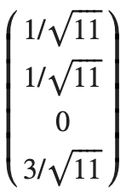
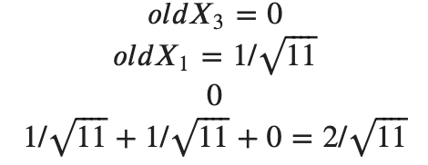
Power Method (cont)
A
[3]
[1]
[]
[1,2,3]
X
AX
=

Slide 12
Module 2

Slide 13
BEVANS TREE
Every processor reads in a portion of the metadata.txt file and compiles a local dictionary of words without repeats.
Root Gathers every local dictionary and inserts them into the tree.

